Slide 1

SQL Hour: An Introduction to writing SQL Queries
Gethyn Ellis

Slide 2

Why you need to write SQL Queries
Data driven world
A lot of data sits in relational databases
Data driven decision making

Slide 3
Where to start
So you want to write SQL queries, where do you start?
Some useful free resources
W3Shools.com
Websites
Forums
Practice
Webinars
Some useful paid for resources
Books
Training Courses
DP-080

Slide 4




About me
Gethyn Ellis
Microsoft, Azure, Power Platform Trainer
www.gethynellis.com
gethyn@gethynellis.com
Twitter: @gethyn_ellis
LinkedIn: https://www.linkedin.com/in/gethynellis/

Slide 5
What do you need if you want to follow along
We will be using
SQL Server Developer Edition
SQL Server Management Studio
AdventureWorksLT2019 database

Slide 6
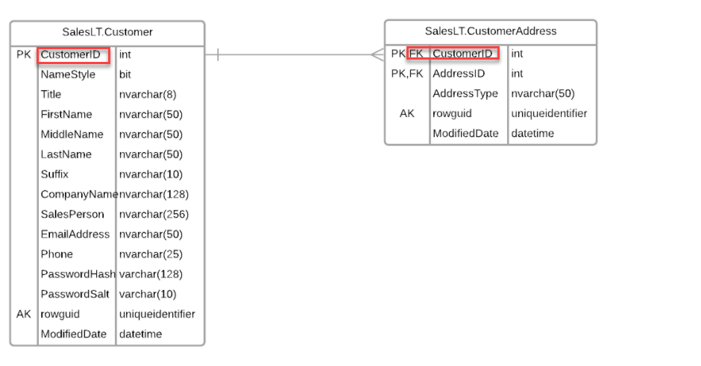
Database Fundamentals
Why you need to write SQL
What you might be concerned with
What is Structured Query Language
Fundamental building blocks
A table
Rows and columns

Slide 7
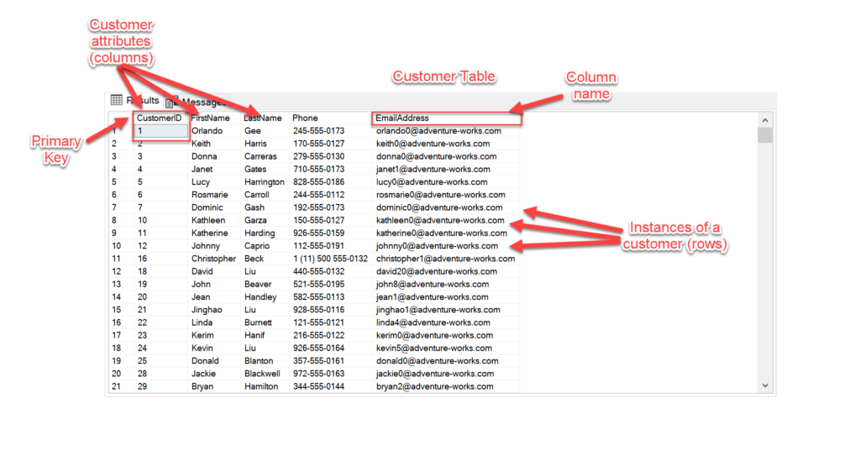
Database fundamentals: Columns Rows and Primary Keys
Columns rows and primary keys
Relationships between tables
Primary foreign keys
Now lets write some queries

Slide 8
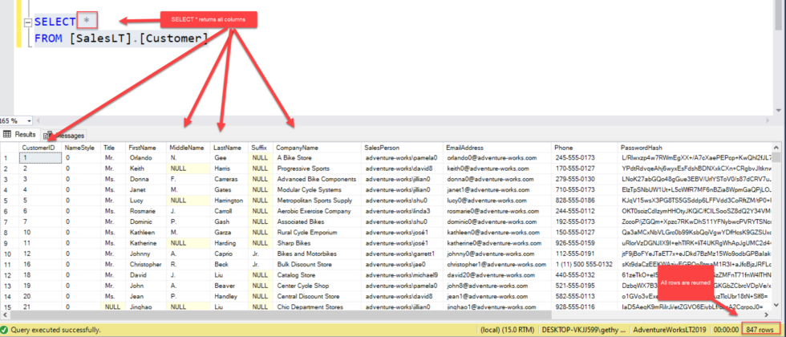
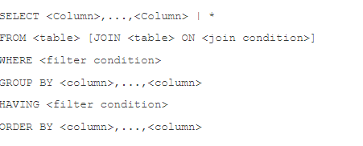
SIMPLE SELECT
SELECT Statement Overview

Slide 9
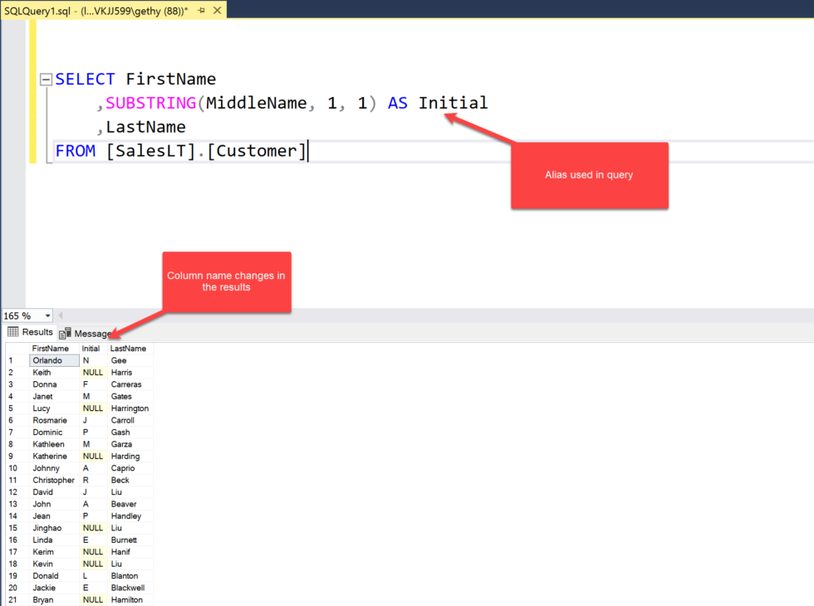
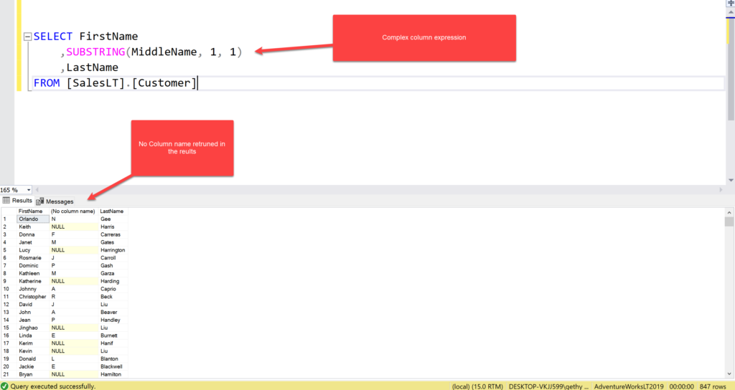
Columns and Expressions
Column expressions can be
A plain column
A constant
A subquery
A combination of the above
Column expressions and Aliases
Rename column header in results
Accidental aliases

Slide 10
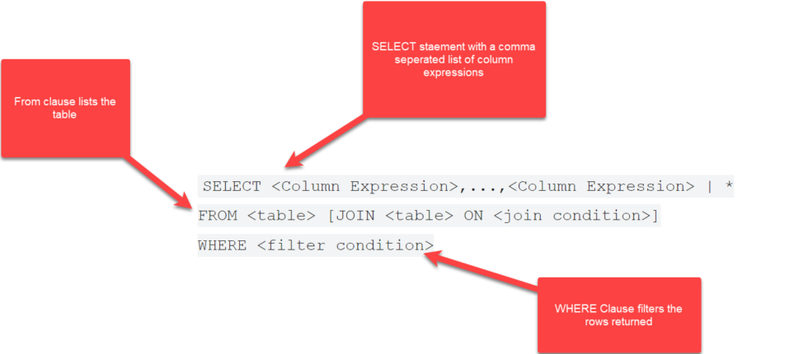
Filter with a WHERE Clause
The WHERE clause will filter rows
There are numerous operators that can be used to build your WHERE clause and reduce the rows returned by your query, including:
You can test for equality =
You can test for inequality <>
Greater than <
Less than >
Greater than or equal >=
Less than or equal <=
We can test for several values using IN and NOT IN
Search intervals using BETWEEN
IS NULL and IS NOT NULL can be used to filter on NULLs
Wildcard searches using LIKE

Slide 11
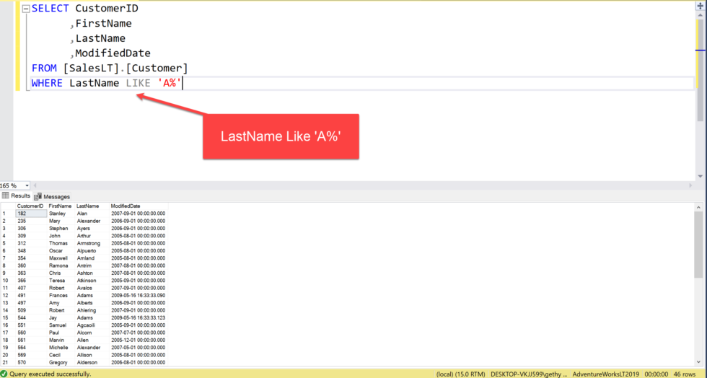
Using LIKE for wildcard searches
The LIKE operator can be used in a WHERE condition to search for Wildcards, the like operator uses the % (percent) symbol and the _ (underscore) characters as special characters.
% means any number (including zero or none) of any characters.
_ means any character but exactly one occurrence of it.
Again, let’s put this into some context and use it in a WHERE condition. Let’s look at some patterns
‘A%’ will find all rows that start with an A
‘%B’ Will find all rows where the last character is B
%C% will contain at least one C
_G% the second character is a G

Slide 12
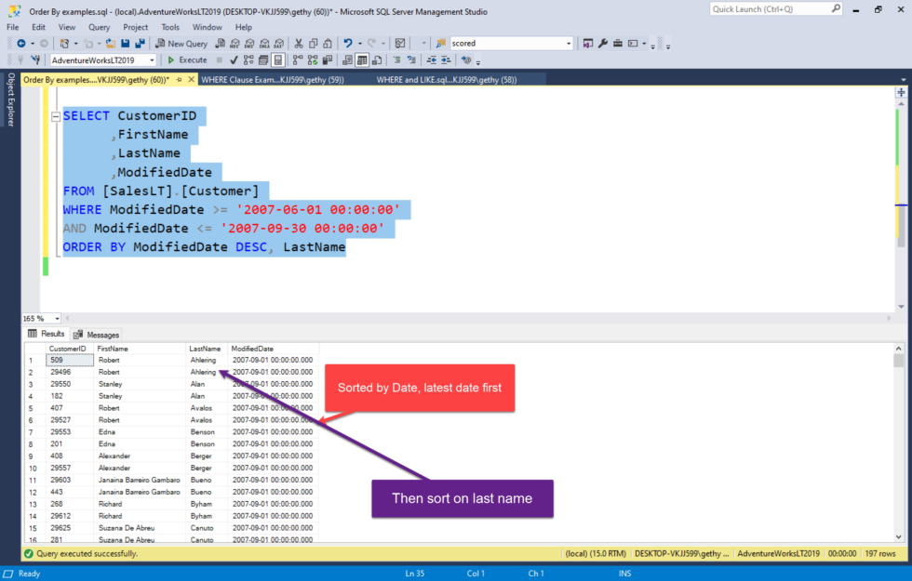
Using Order By to sort
If you want to sort your results you must use the ORDER BY clause
You can sort by
Column name
Column expression
Relative column position – so you can say ORDER BY 1 and that will sort on the first column in the results
You can sort by the column alias… Remember column aliases?

Slide 13
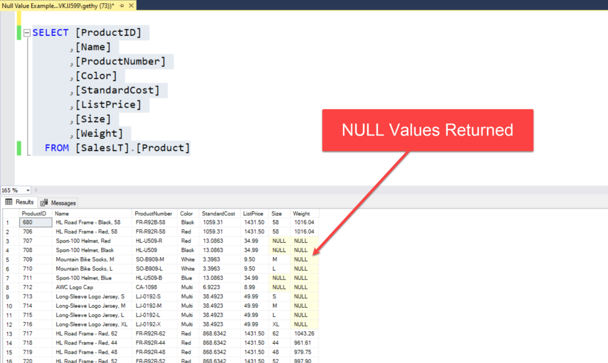
Understanding Nulls
A NULL is an unknown or missing value.
The data doesn’t exist in the database.
If your column ALLOWS NULL then when you insert data into that table the database engine won’t force you to enter a value for that column.
There are functions in SQL that can be used to help you deal with NULLs
So null is an unknown or missing value, NULL IS NOT:
The same as zero
The same as blank
and it’s important to remember it’s not the string “NULL” either

Slide 14
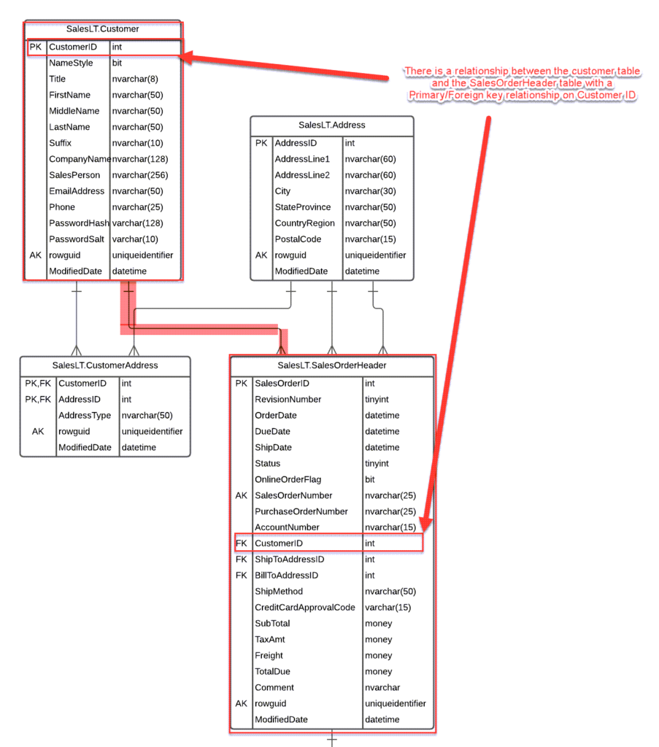
Inner Join
How do you retrieve data from multiple tables
You use a join

Slide 15
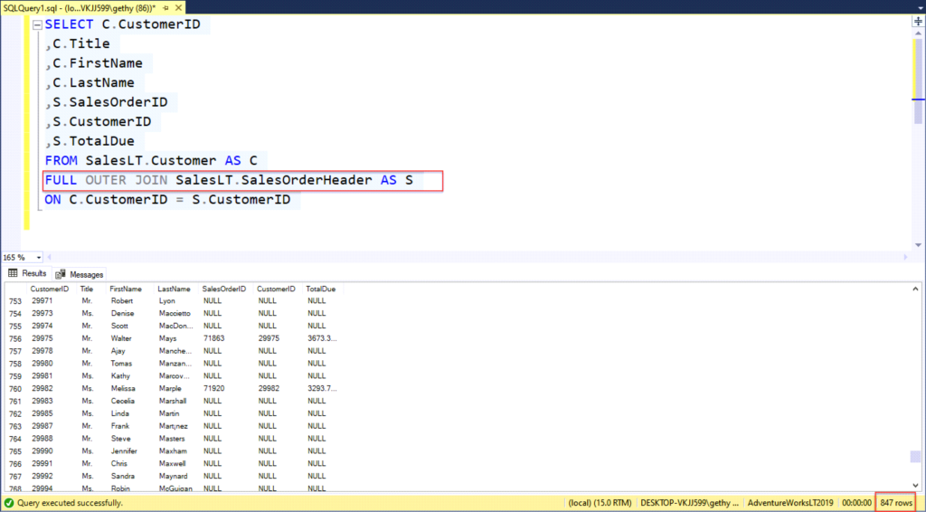
Outer Join
Retrieve Data From Multiple Tables - Outer Joins
Left outer joins
Right outer joins
Full outer joins

Slide 16

Come on our training course
Querying Data with Microsoft Transact-SQL (DP-080)
June 16th 17th
£750 plus VAT
50% off
Use promo code SQLHOUR
info@gethynellis.com
https://www.gethynellis.com/querying-data-with-microsoft-transact-sql-training-dp-080

Slide 17

Questions

